Slide 1
Task 4: Zero PCB implementation of transmitter side
Submitted By:
Komal preet kaur
Group_3
Submitted to:
Prof. mike aleshams

Slide 2
Table of Contents:
Block diagram of transmitter side
Components and protocols used
ZigBee module and its interfacing diagram
Touch LCD and its interfacing diagram
Final Schematic diagram of transmitter side circuit
Gerber file(PCB design of transmitter side)
PCB and its types
Zero PCB
Components needed for Zero PCB implementation
Soldering
PCB testing after implementation

Slide 3
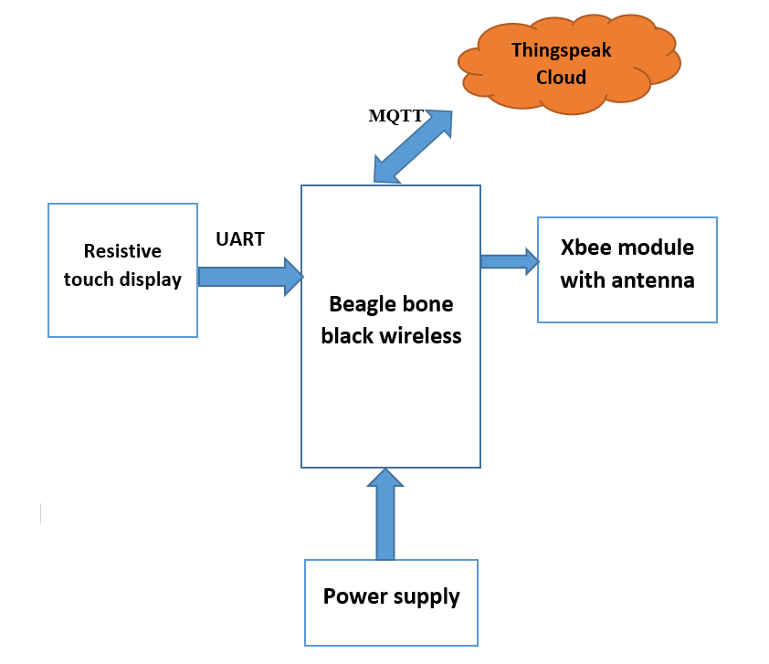
Block diagram of transmitter side

Slide 4
Components and communication protocols used:
Components used at Transmitter Side:
Beaglebone Black Wireless
Xbee Module
Nextion Touch LCD
Communication Protocol Used:
UART

Slide 5
Xbee S2C module:
XBee S2C is a RF module designed for wireless communication or data exchange and it works on ZigBee mesh communication protocols.
The module provides wireless connectivity to end-point devices in any ZigBee mesh networks including devices from other vendors.

Slide 6
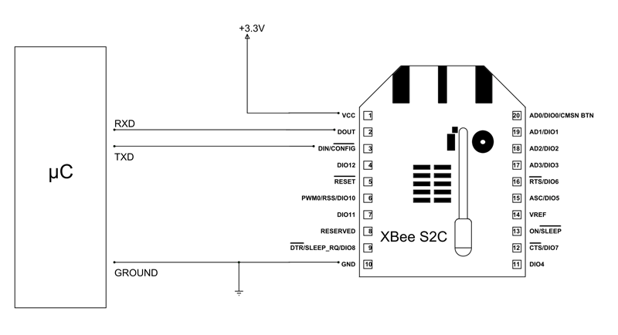
Interfacing of Xbee module with Beaglebone:

Slide 7
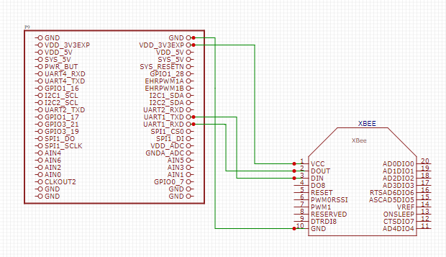
Interfacing of Xbee module with Beaglebone:
Connect pin 1 (Vcc) of XBEE to pin4 (Vdd) of BBB wireless (P9 Header)
Connect pin 10 (GND) of XBEE to Pin 46 (GND) of BBB wireless (P9 header )
Connect pin 2 (Dout) of XBEE to pin26 (UART1_Rx) of BBB wireless (P9 Header)
Connect pin 3 (Din) of XBEE to Pin 24 (UART1_Tx) of BBB wireless (P9 header )

Slide 8
Nextion Touch LCD
Nextion NX4827T043 4.3 Inch HMI Intelligent Smart UART Serial Touch TFT LCD Screen Module Display Panel.
Nextion is a Seamless Human Machine Interface (HMI) solution that provides a control and visualization interface between a human and a process, machine, application or appliance. Nextion includes hardware part (a series of TFT boards) and software part (the Nextion Editor).
The Nextion TFT board uses only one serial port to communicate. It lets you avoid the hassle of wiring..
In Nextion editor, has mass components such as button, text, progress bar, slider, instrument panel etc. to enrich your interface design.

Slide 9
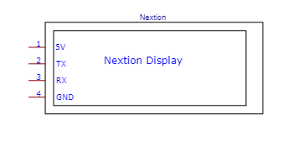
Nextion display : Pin description

Slide 10
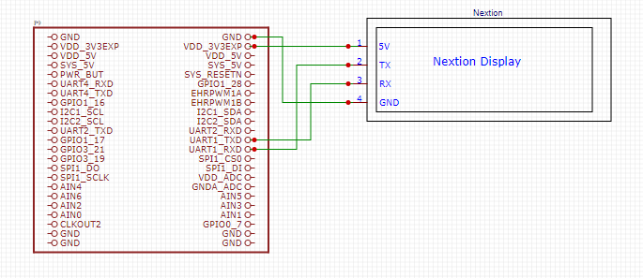
Interfacing of Touch LCD with Beaglebone:
Connect pin 1 (Vcc) of XBEE to pin4 (Vdd) 0f BBB wireless (P9 Header)
Connect pin 4 (GND) of XBEE to Pin 46 (GND) of BBB wireless (P9 header )
Connect pin 2 (Tx) of XBEE to pin26 (UART1_Rx) 0f BBB wireless (P9 Header)
Connect pin 3 (Rx) of XBEE to Pin 24 (UART1_Tx) of BBB wireless (P9 header )

Slide 11
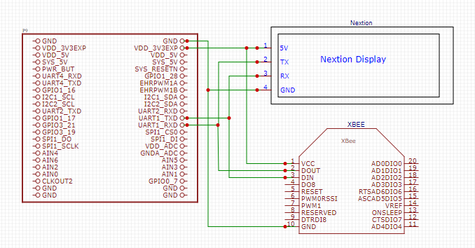
Final Schematic of Transmitter side:

Slide 12
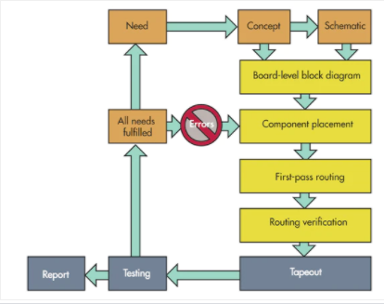
The Basic PCB Design Process:
It includes the design’s features, the functions the PCB must have and perform, interconnection with other circuits, placement, and the approximate final dimensions.
The ideal PCB design flow begins when designers recognize a need that must be fulfilled, and it doesn’t end until testing verifies that the design can meet those needs.

Slide 13
Gerber file:
The Gerber file set is PCB jargon for the output files of the layout that are used by PCB manufacturers to create the PCB. A complete set of Gerber files includes output files generated from the board layout file:
Silkscreen top and bottom
Solder mask top and bottom
All metal layers
Component map (X-Y coordinates)
Assembly drawing top and bottom
Drill file
Drill legend
FAB outline (dimensions, special features)
Netlist file

Slide 14
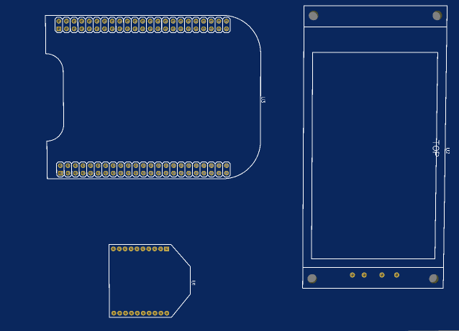
PCB Design Top layer:

Slide 15
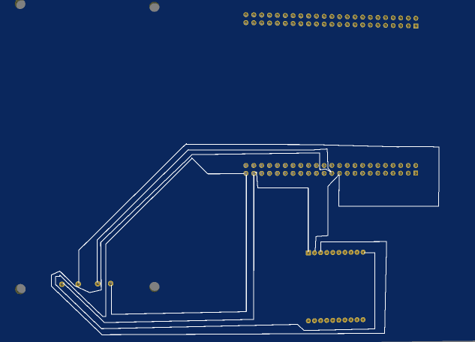
PCB Design Bottom layer:

Slide 16
What is PCB (Printed Circuit Board)
PCB holds all the electrical components mechanically & connects them using conductive pads, tracks & other allied features.
PCBs are primarily categorized based on the method of construction for example:
Single-Sided PCBs, Double-Sided PCBs, Multilayer PCBs& more

Slide 17
Types of PCB:
Single-Sided PCBs
Double-Sided PCBs
Multilayer PCBs
Rigid PCBs
Flex PCBs
Rigid-Flex PCBs
Zero PCB(General purpose PCB)

Slide 18
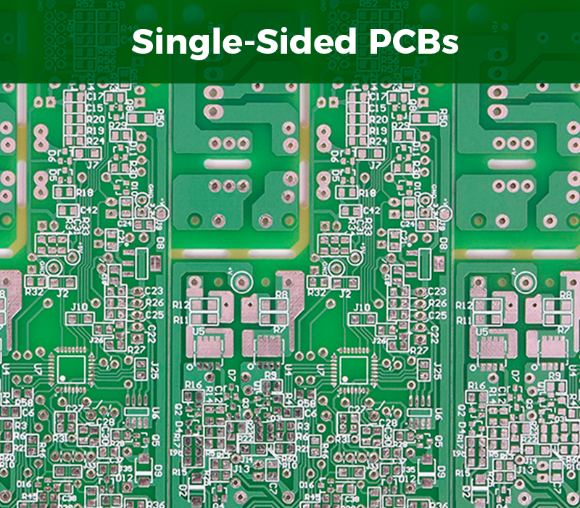
Single Sided PCB’s
The single-sided printed circuit board comprises of a single layer or substrate.
A thin layer of metal (preferably copper) is coated on one end of the substrate. Copper is used since it is a good conductor of electricity.
The single sided PCB manufacturing process ensures that all the circuits & electronic components are placed on a single side.
The mass-production of these boards costs less. But, the flip side is these boards are used rarely due to its design limitations.

Slide 19
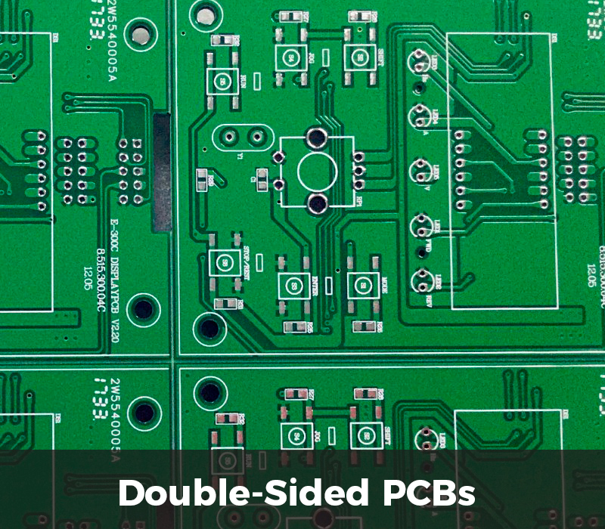
Double sided PCBs
As the name suggests, Double-sided Printed Circuit Board comprise of electrical elements & conductive layers on both sides.
The Double-Sided PCBs consist of holes which enables connection of circuits from one side to another.
Two techniques are used to connect the circuits on both the layers – Through-hole & Surface mount technology.
While the through-hole method enables feeding small wires through holes, surface mount technology uses little leads which are soldered onto the board.

Slide 20
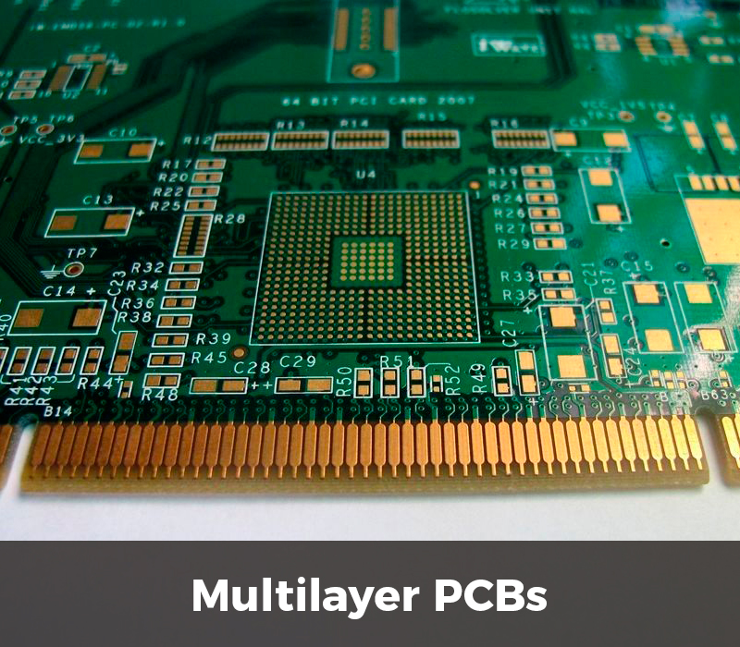
Multilayer PCBs
The Multilayer Printed Circuit Board’s characterized by more density & complexity. This is due to the addition of layers beyond the top & bottom layers of PCB.
The increased density & complexity gives PCB designers the ability to make highly compound & thick designs.
Extra layers comprise of power planes which supply the circuit with power while decreasing electromagnetic interference levels.
Lower electromagnetic interference levels ensure the good health maintenance of circuit performance.

Slide 21
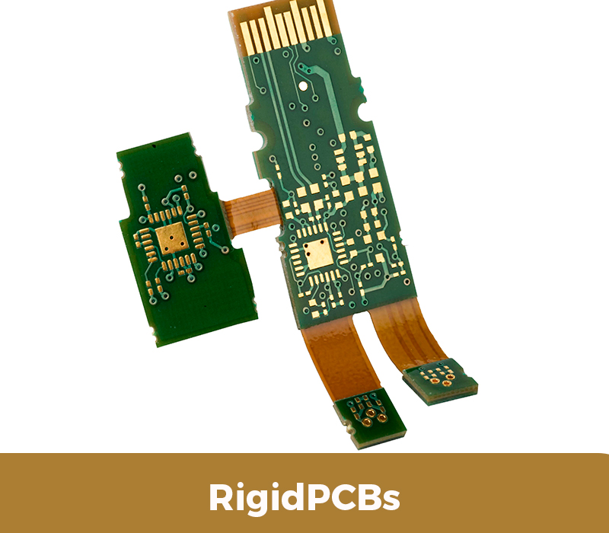
Rigid PCBs
The Rigid printed board circuit’s rigid or inflexible in nature.
Rigid PCBs are among the initial types of Printed Circuit Boards due to its simplistic design & ease of use.
The benefits of Rigid printed board circuit are its compact size, low electronic noise, ability to absorb vibrations, ease of diagnostics & Repair.

Slide 22
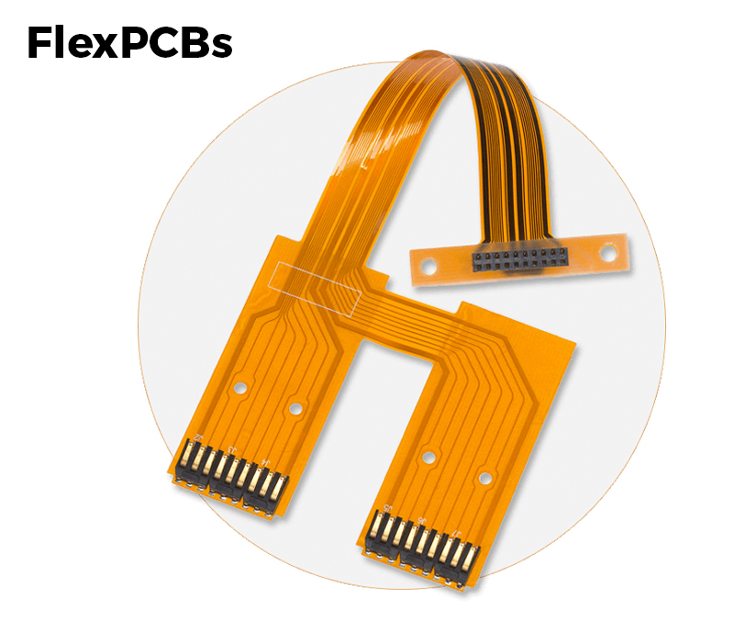
Flex PCBs
Flex Printed Circuit Board brought the advent of new-age technology.
The Flex PCBs are manufactured to power wearables & other allied products.
Its smaller density as well as flexibility reduces the assembly process & improves reliability.
Flexible PCB prototyping and manufacturing can be further enhanced by using reinforced materials or base material.

Slide 23
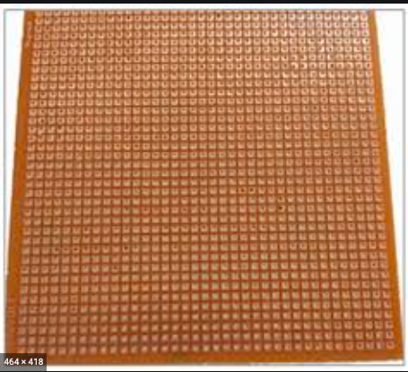
Zero PCBs
Zero PCB is basically a general-purpose printed circuit board (PCB), also known as perfboard or DOT PCB.
It is a thin rigid copper sheet with holes pre-drilled at standard intervals across a grid with 2.54mm (0.1-inch) spacing between holes.
Each hole is encircled by a round or square copper pad so that component lead can be inserted into the hole and soldered around the pad without short-circuiting the nearby pads and other leads.
For connecting the lead of component with another lead, we solder these together or join these using a suitable conducting wire.

Slide 24
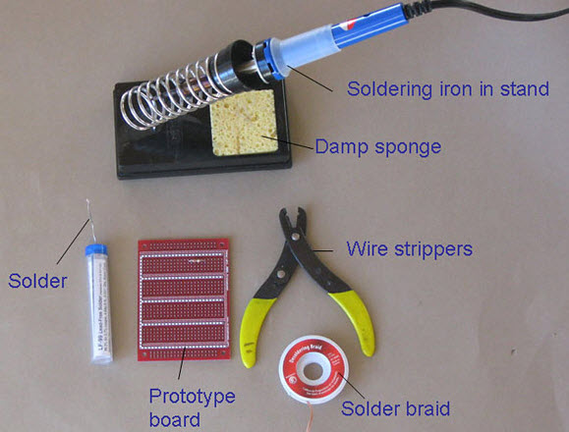
Soldering:
For soldering we require:
Soldering Lead
Soldering Iron
Flux along with a printed circuit board and layout diagram of the circuit.

Slide 25
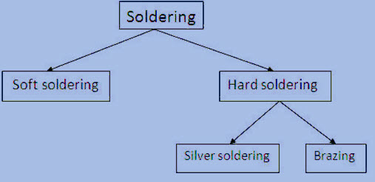
Types of soldering

Slide 26
Soldering iron:
Soldering iron is the required primary thing, which is used as a heat source for liquefying solder.
15W to 30W soldering guns are good for the majority of electronics or PCB (printed circuit board) jobs.
The major difference between a gun and an iron is that iron seems like a pencil and comprises of a pin-point heat supply for the precise job, whereas a gun is like a gun in shape with a high wattage point excited by running electrical current simple through it.

Slide 27
Solder flux Soldering Paste
Flux is a chemical purifying agent
In soldering metals, flux provides three functions:
it eliminates rust from the components to be soldered
it closes air out as a result ending extra rust
Making easy mix improves dripping individuality of the fluid solder.
Soldering cream is employed to connect the leads of included chip packages to connection ends in the circuit blueprint on a PCB.

Slide 28
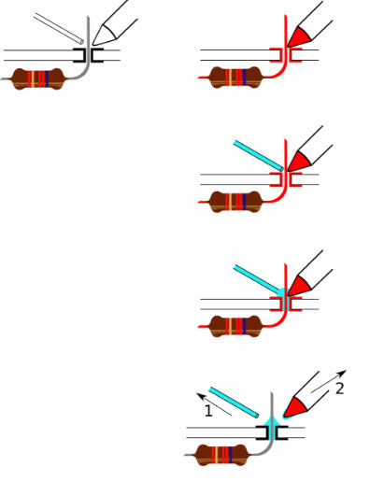
Soldering Process:
Start with the small components to the taller components and connecting wires
Place the element into the PCB, making sure it goes in the correct way around and twist the leads a little to secure the part.
Make sure the soldering iron has warmed up and if required, use the moist sponge to clean the tip.
Place the soldering iron on the component of the pad and feed the solder’s end onto the board
Take away the solder and the soldering iron from the board and leave the terminal to cool for a few seconds.
Using a couple of cutters neat the excess component terminal
If you make a mistake while heat up the joint with the iron, place the solder tip of your solder extractor and push the button.

Slide 29
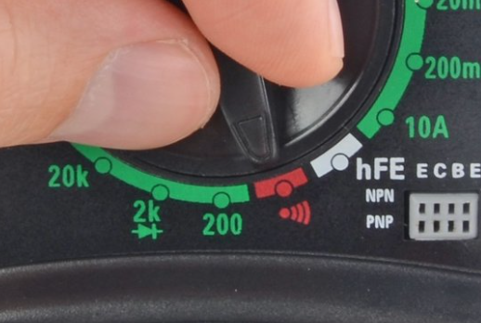
PCB Testing
Testing Continuity:
A continuity test tells us whether two things are electrically connected,if something is continuous, an electric current can flow freely from one end to the other.
To begin, make sure no current is running through the circuit or component we want to test. Switch it off, unplug it from the wall, and remove any batteries.
Plug the black probe into the COM port on your multimeter.
Plug the red probe into the VΩmA port.
Switch on the multimeter, and set the dial to continuity mode

Slide 30
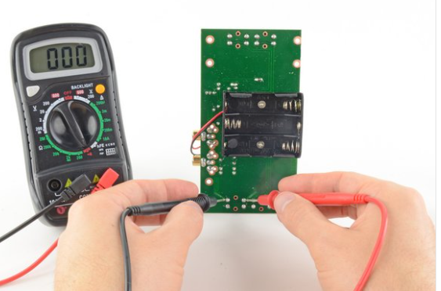
Testing Continuity:
The multimeter tests continuity by sending a little current through one probe, and checking whether the other probe receives it.
If the probes are connected—either by a continuous circuit, or by touching each other directly—the test current flows through. The screen displays a value of zero (or near zero), and the multimeter beeps.
If the test current isn't detected, it means there's no continuity. The screen will display 1 or OL (open loop).
To complete continuity test, place one probe at each end of the circuit or component we want to test.

Slide 31
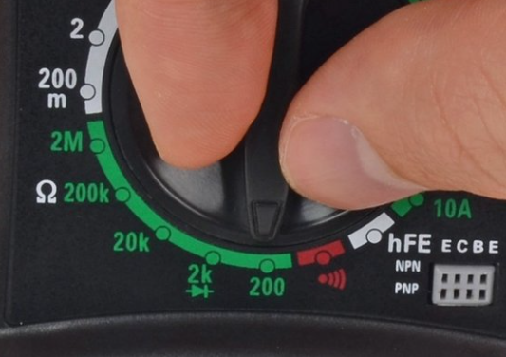
Testing Continuity:
If multimeter doesn't have a dedicated continuity test mode, we can still perform a continuity test.
Turn the dial to the lowest setting in the resistance mode.
If the probes are connected—either by a continuous circuit, or by touching each other directly—the test current flows through. The screen displays a value of zero (or near zero—in this case, 0.8). Very low resistance is another way of saying that we have continuity.
If no current is detected, it means there's no continuity. The screen will display 1 or OL (open loop).

Slide 32
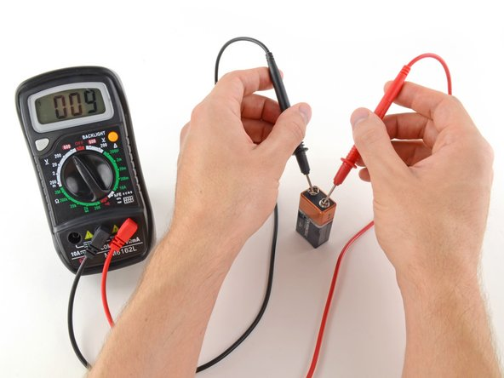
Testing Voltage:
Set the dial to DC voltage mode.
Set the correct range for voltage.
Place the red probe on the positive terminal, and the black probe on the negative terminal.
With the range set correctly, we get an accurate reading.

Slide 33
References:
XBee S2C ZigBee (Wire Antenna). Retrieved from elediy.com:
https://elediy.com/products/xbee-s2c-zigbee-wire-antenna
XBee pin-out description. Retrieved from components101.com
https://components101.com/wireless/xbee-s2c-module-pinout-datasheet#:~:text=XBee%20S2C%20is%20a%20RF,including%20devices%20from%20other%20vendors
Interfacing of BB-WI with touch screen display. Retrieved from 14core.com
https://www.14core.com/working-with-nextion-hmi-gui-tft-touch-display/
Testing PCB with DMM
https://www.ifixit.com/Guide/How+To+Use+A+Multimeter/25632

Slide 34
References:
Soldering – retrieved from:
https://www.elprocus.com/different-methods-of-soldering-the-electronic-components/
Types of PCB’s –retrieved from:
https://www.crimpcircuits.com/blog/types-of-printed-circuit-boards/
Zero PCB –retrieved from:
https://www.electronicsforu.com/technology-trends/learn-electronics/veroboard-zero-pcb-difference#:~:text=Zero%20PCB%20is%20basically%20a,%2Dinch)%20spacing%20between%20holes.
PCB design process:
https://www.electronicdesign.com/technologies/embedded-revolution/article/21798594/the-engineers-guide-to-highquality-pcb-design

Slide 35
Thank you

